Slide 1
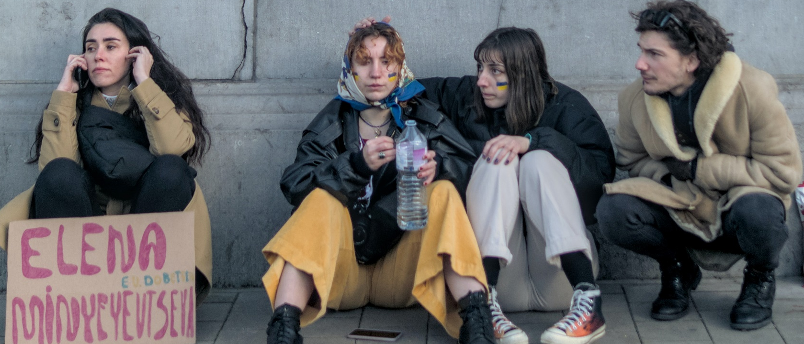
HELP
UKRAINE

